Slide 1


A Study on CNN Classificatioin: Detecting Skin Cancer
Group 17
Group members:
Luyue Chen, Guoyong Xu, Hanyu Gao, Yanzhu Chen, Zhaochen Li, Xuanhong Ye, Lulu Wang, Kanyan Chen

Slide 2






Our Dataset & EDA
Our Model
Model Performance
What Else

Slide 3


Our Dataset & EDA

Slide 4

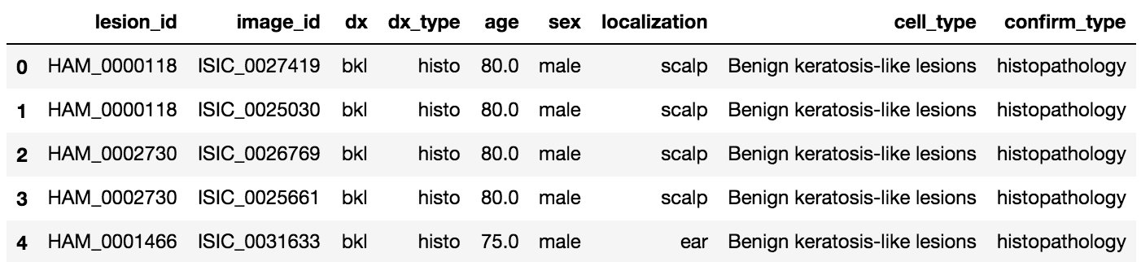
Our dataset
Cell Type(dx):
nv: Melanocrytic nevi
mel: Melanoma
bkl: Benign keratosis-like lesions
bcc: Basal cell carcinoma
akiec: Actinic keratoses
vasc: Vascular lesions
df: Dermatofibroma
A large collection of multi-source dermatoscopic images of common pigmented skin lesions
Data Source: https://challenge2018.isic-archive.com/
Notes:
The dataset includes lesions with multiple images, which can be tracked by the lesion_id-column within the HAM10000_metadata file.
age type
sex type
age sex
local type

Slide 5
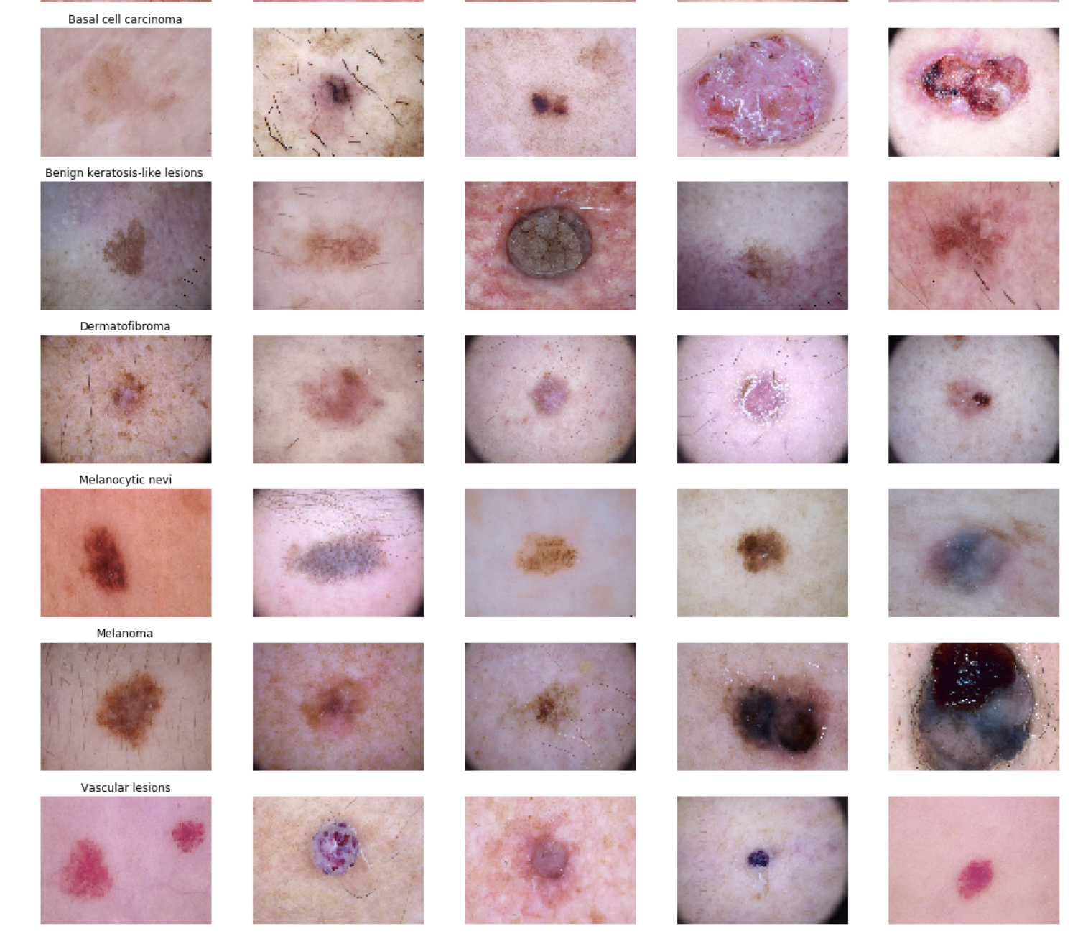
Our dataset
Notes:
The dataset includes lesions with multiple images, which can be tracked by the lesion_id-column within the HAM10000_metadata file.
age type
sex type
age sex
local type

Slide 6
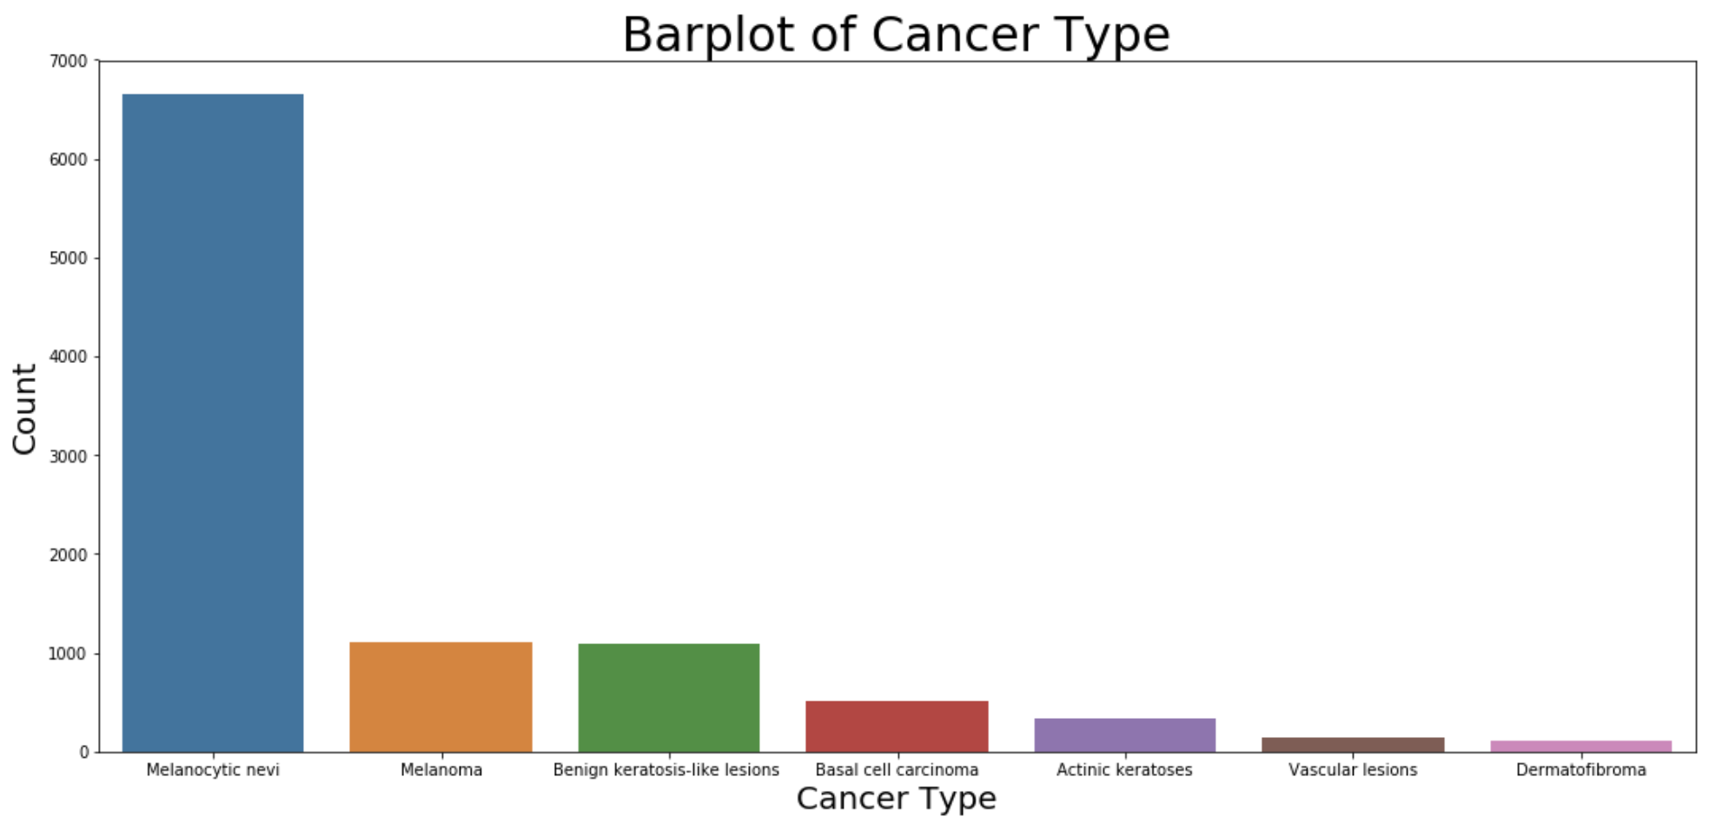
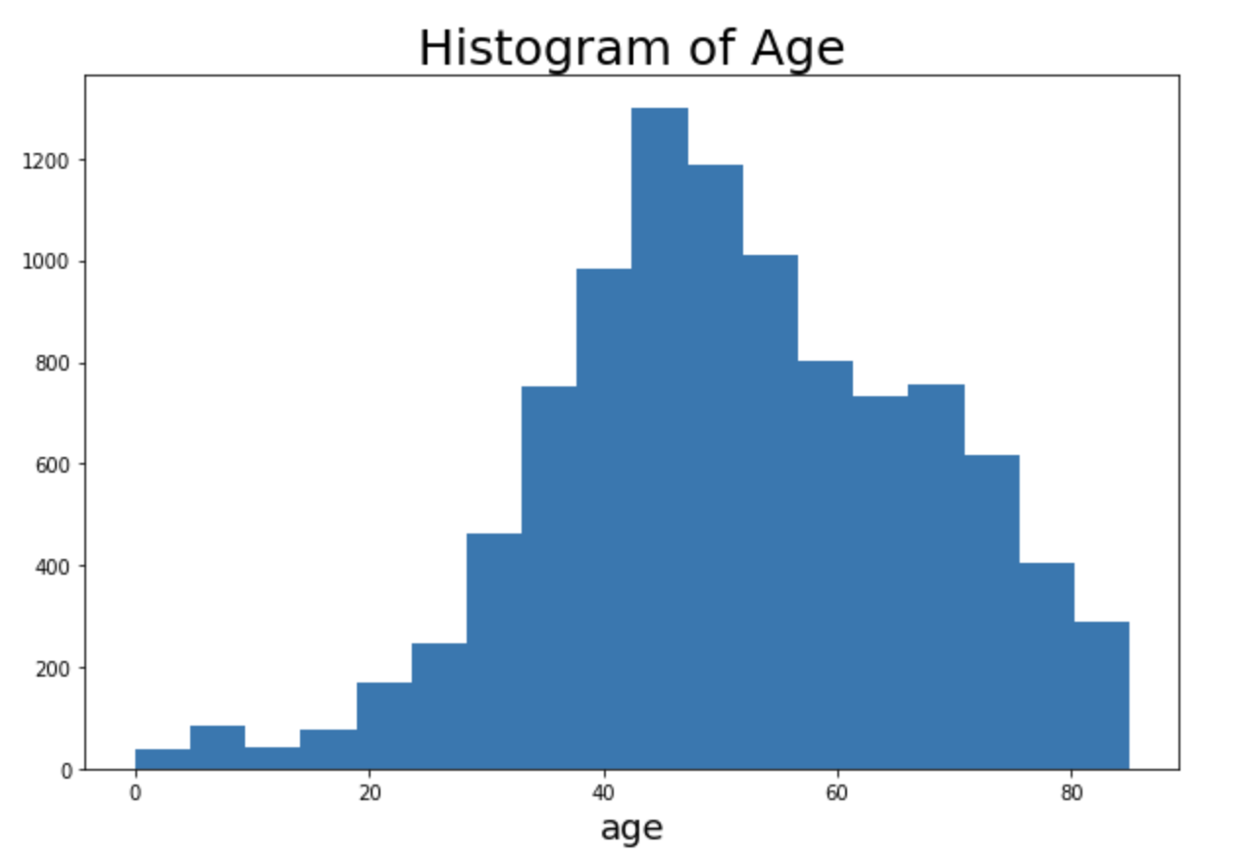
Exploratory Data Analysis
Histogram of age: most patients between 35 to 70.
Histogram of lesion types: ‘nv’ type is greater than 66%.
Notes:
age distribution
number of every cancer
location of cancer

Slide 7
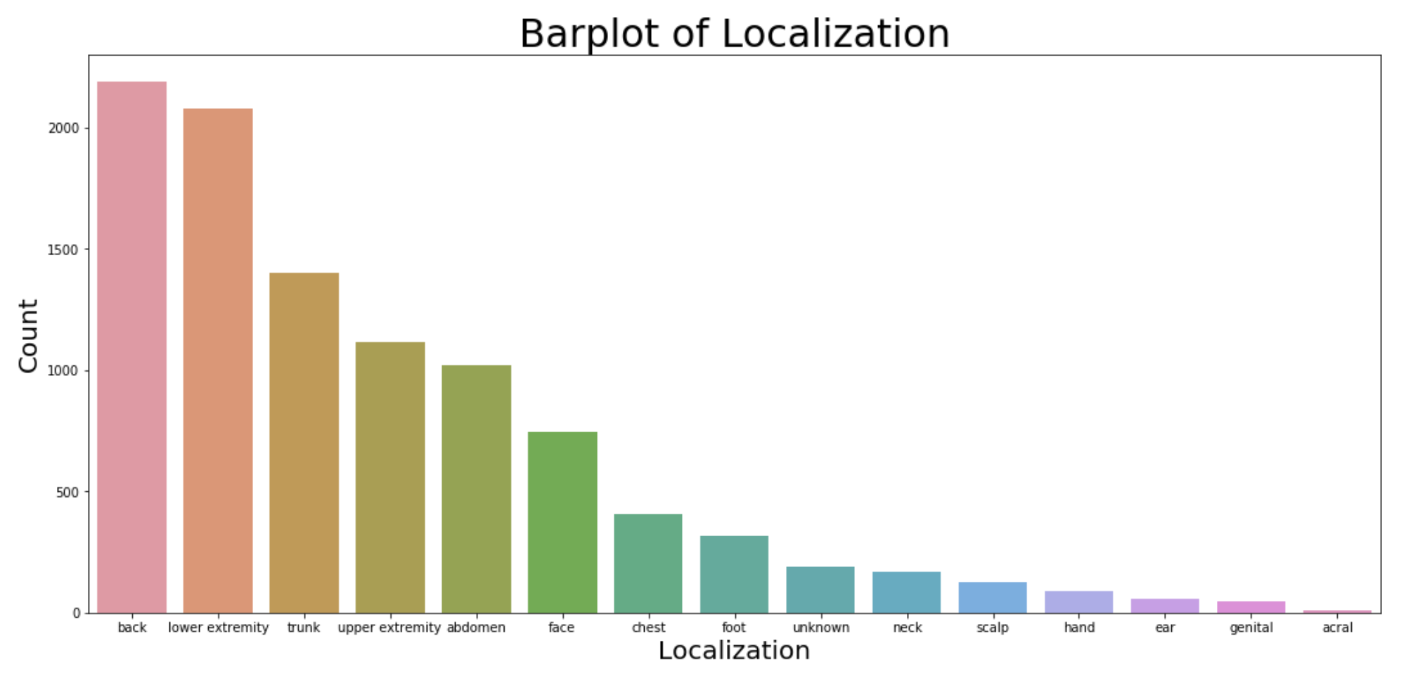
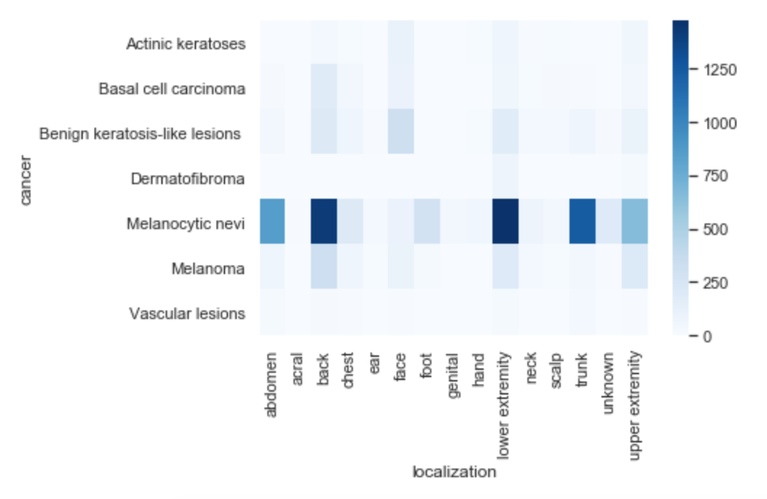
Exploratory Data Analysis

Slide 8
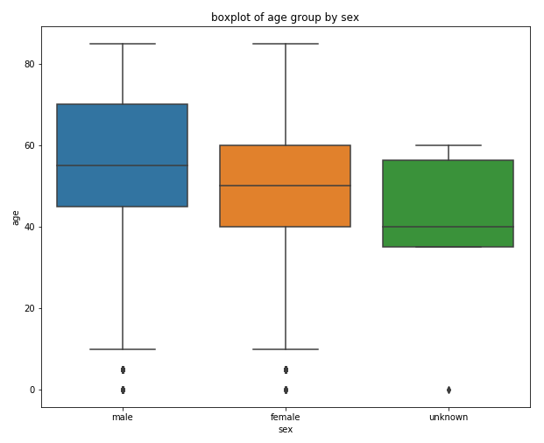

Dependence between age and sex
Age distribution for male and female are different
Notes:
We also did the box plot for the ages from different kinds of group methods which are patients’ sex, cell type and confirm type.
For example, by grouping the data with sex, we found that the men are generally detected skin cancer later than women and the people less than 10 years old can be considered as outlier.

Slide 9
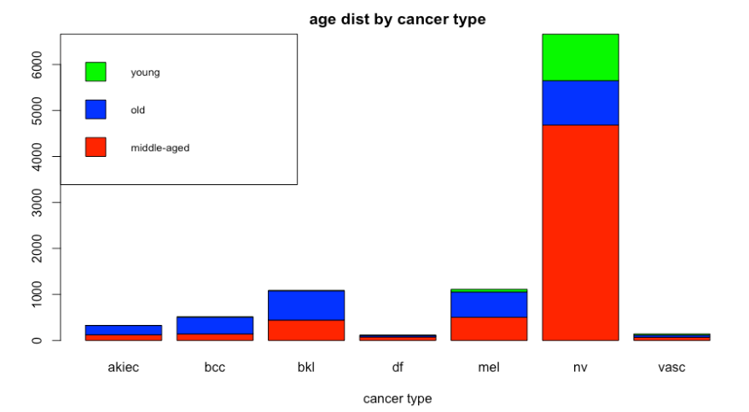
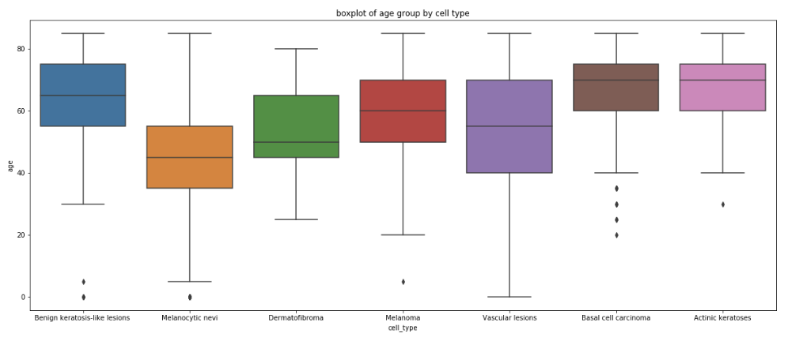

Dependence between age and cancer type
Age and cancer type are dependent

Slide 10
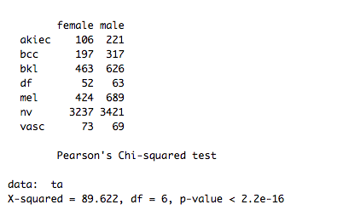
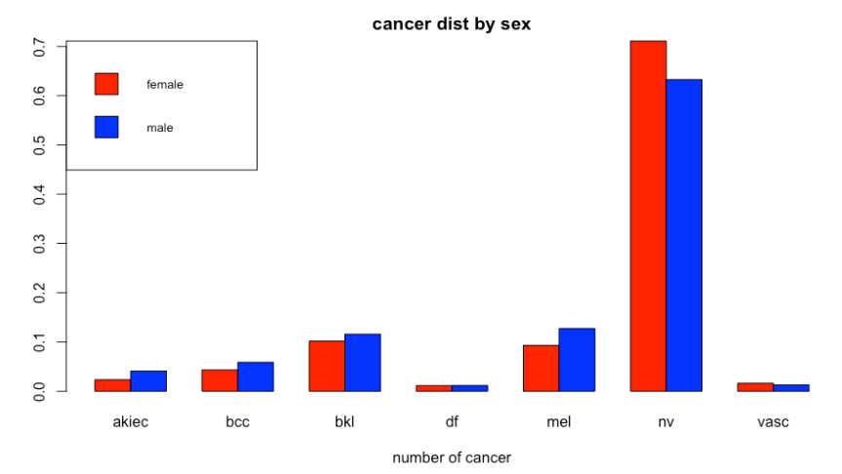
Dependence between cancer type and sex
Cancer type and sex are dependent

Slide 11

Our Model

Slide 12

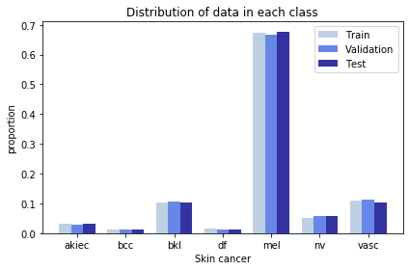
Data Preprocessing
(224,224,3) pixels scale to [0,1]
Split data into train, validation, test set: 6:3:1
train set | validation set | test set
6000 | 3000 | 1015
Original
Data
Prepocessed
Data
Notes:
In this part we try to detect 7 different classes of skin cancer using transfer learning of CNN with keras tensorflow in backend and then analyse the result to see how the model can be useful in practical scenario.

Slide 13

Model Performance

Slide 14
CNN model & Transfer Learning
MobileNetV2:
a pretrained convolutional neural network which has 156 layers.
model_transfer = tf.keras.Sequential([
MobileNet,
tf.keras.layers.GlobalAveragePooling2D(),
tf.keras.layers.Dense(512,activation='relu'),
tf.keras.layers.Dense(7,activation='softmax')
])
model_transfer.compile(loss='categorical_crossentropy', optimizer='adam', metrics=['accuracy'])
Notes:
Based on the pretrained model MobileNetV2, we further added one pooling (GlobalAveragePooling2D) layer, which simply acts as a flatten filter. It looks at the 7*7 pixels matrix and takes the average value. These are used to reduce computational cost, and to some extent also reduce overfitting. In the end we used the features in two fully-connected (Dense) layers which is just an artificial neural networks (ANN) classifier. In the last layer(Dense(7,activation="softmax")) the net outputs distribution of probability of each class.
Once our layers are added to the model, we need to set up a score function, a loss function and an optimisation algorithm. We define the loss function to measure how poorly our model performs on images with known labels. It is the error rate between the observed labels and the predicted ones. We use a specific form for categorical classifications (>2 classes) called the "categorical_crossentropy".
We chose Adam optimizer because it combines the advantages of AdaGrad and RMSProp, it is a popular algorithm in the field of deep learning because it achieves good results fast.
metric function "accuracy" is used is to evaluate the performance of our model. This metric function is similar to the loss function, except that the results from the metric evaluation are not used when training the model (only for evaluation).

Slide 15
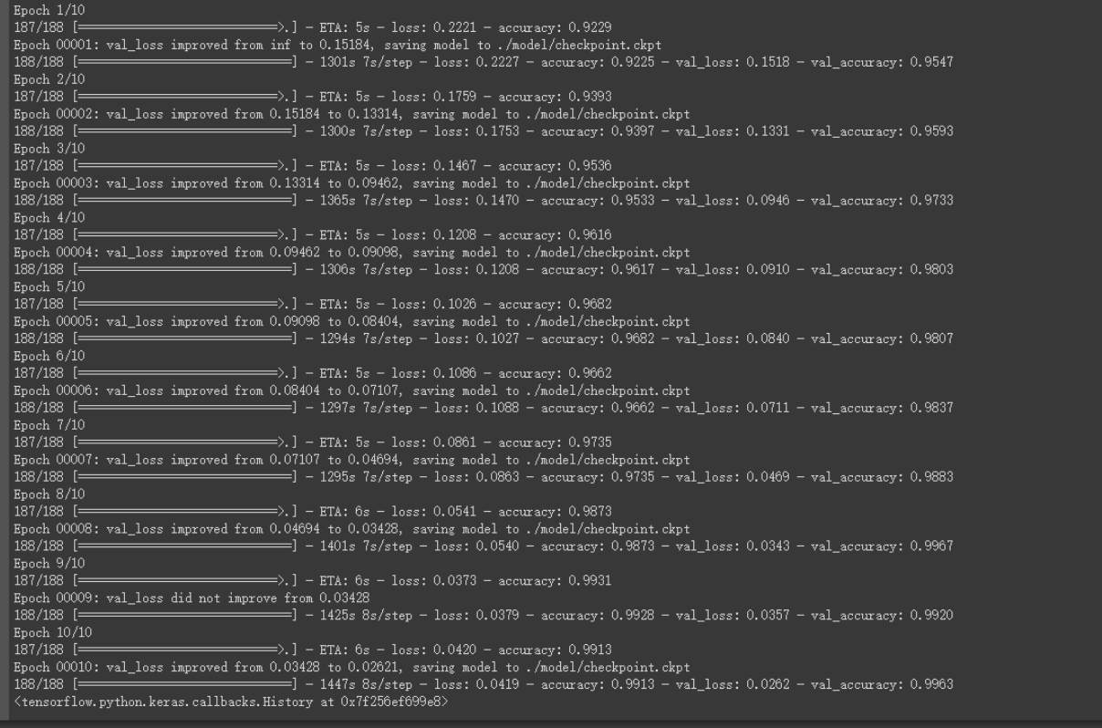
Model Training
We used 26 epochs to train the model
the batch size is 32
The total training time is about 14 Hours

Slide 16
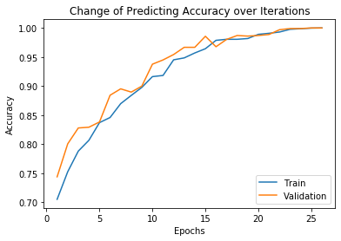
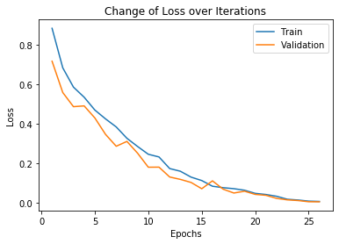
Model Performance
Notes:
According to validation loss, we choose the weights of 26th epoch as our trained model, and then apply it on our test data, which results in the test accuracy of 100% and loss of 0.004
Why validation accuracy > training accuracy?
Because in the pretrained model, it has several drop out layers, in the training process, the drop out layers simply act like downsampling filter and drop out some features thus avoid overfitting, which can somehow lead to information loss, while in validating process, the drop out function will no longer work.

Slide 17

What Else

Slide 18

Model Application - A Simple App
We made a simple py app based on the trained model.
Notes:
So we build a simple python app, though we are still working on designing the UI of our app, the core is as it shows here.
When we run the app, it will ask us to input the image path, then it will output the corresponding skin cancer type.

